Slide 1
INSTAGRAM USER ANALYTICS
By DIKSHA SANTOSH AUSEKAR

Slide 2
OUTLINE
PROJECT DESCRIPTION
APPROACH
TECH-STACK USED
INSIGHTS
RESULTS

Slide 3
PROJECT DESCRIPTION
This project involves using SQL and MySQL Workbench to analyze user interactions and engagement with the Instagram app. The goal is to provide insights that can help the business grow, such as identifying loyal users, encouraging inactive users to post, and determining the best time to launch ad campaigns. The findings will be used by the product team to make informed decisions about the app's future development.

Slide 4
APPROACH
STEP 1: Understanding the data.
STEP 2: Grasping the Question.
STEP 3: Writing SQL Queries for each Question and Executing in MySQL Workbench.
Step 4: Analyzing the Results for Insights.
Step 5: Providing recommendations based on insights.

Slide 5
TECH-STACK USED
MySQL WorkBench 8.0 CE :
Used to manage the database and execute SQL queries. Best known for its easy-to-use interface and strong capabilities for data analysis.
This is a free version which to work with MySQL databases without additional cost.
As far as the project is concerned, the free version (CE) of MySQL Workbench will work just as well as the paid version to run SQL queries, analyze Instagram user data and derive insights.

Slide 6
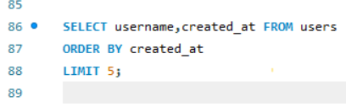
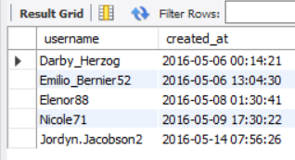
INSIGHTS
Marketing Analysis:
Loyal User Reward:Identify the five oldest users on Instagram from the provided database.
Query The five oldest users on Instagram are:
From the above SQL Query we get the correct insights ie the username along with date and time
when the users registered on Instagram of the 5 oldest users.

Slide 7
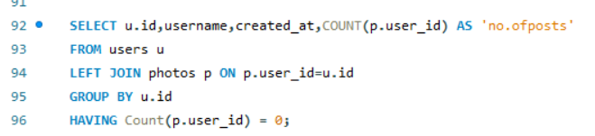
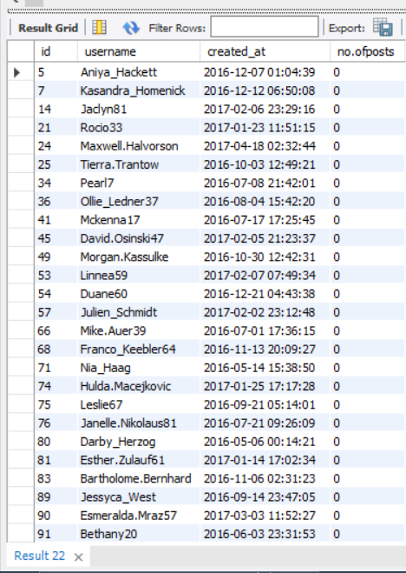
2) Inactive User Engagement : Identify users who have never posted a single photo on Instagram.
Query The list of users who never
posted a single photo
So from the output ,total 26 users have never posted a
Single photo.

Slide 8
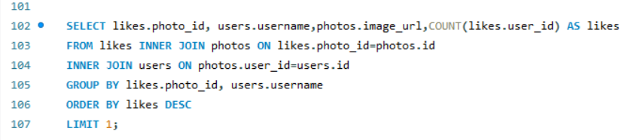
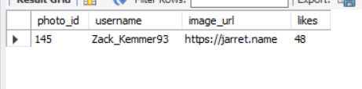
3) Contest Winner Declaration : Determine the winner of the contest and provide their
details to the team.
Query The user with the most likes on a single photo
From the output ,the winner is Zack_Kemmer93 with total likes 48 which is the highest among
all users.

Slide 9
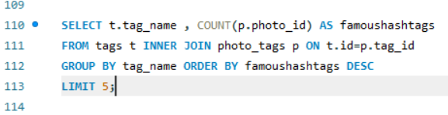
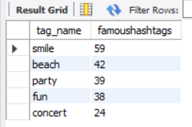
4) Hashtag Research : Identify and suggest the top five most commonly used
hashtags on the platform.
Query The 5 famous hashtags
From the output we can say that smile,beach,party,fun,concert are the 5 most popular
hashtags used on Instagram.

Slide 10
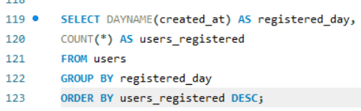
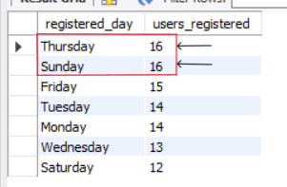
5) Campaign Launch : Determine the day of the week when most users register on
Instagram. Provide insights on when to schedule an ad campaign.
Query Output
There are two days of week as highlighted in the output ,they are Thursday and Sunday.

Slide 11
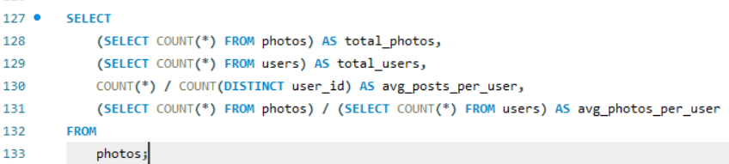

B) INVESTOR METRICS :
6) User Engagement : Calculate the average number of posts per user on Instagram. Also, provide the total number of photos on Instagram divided by the total number of users.
Query
Output

Slide 12
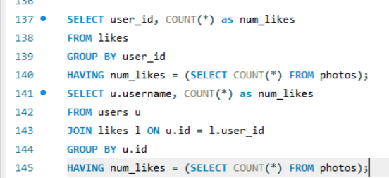
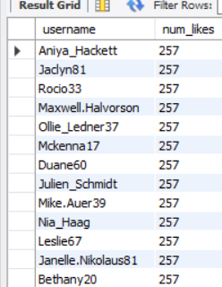
7) Bots & Fake Accounts : Identify users (potential bots) who have liked every
single photo on the site, as this is not typically possible for a normal user.
Query Users who liked every single
photo on instagram
The insights shows usernames who have liked all photos ie 257 . It is not possible to like each of these photos.Therefore the above usernames are fake.

Slide 13
RESULTS
The result of above analysis using SQL Queries and derived insights:
The marketing team can recognize and reward the most devoted customers who have used the platform for the most time.
The marketing team can send out promotional emails to inactive users to get them back on the platform.
The marketing team can use popular hashtags to increase the visibility of the posts and reach a wider audience.
Analyzing the most popular day for brand promotions will help the marketing team plan campaigns for maximum effect.
User engagement is a key metric for measuring the effectiveness of marketing campaigns and business growth.
Removing bots and false accounts from the platform will improve the user experience and keep the platform honest.
What I Learned from this project:
Learned how to use SQL queries to analyze data and extract insights from database.
Tracked how users interact and engage with digital product (whether it’s software or a mobile app) to get business insights for marketing, product and development teams.

Slide 14
THANK YOU!!!

